Slide 1
The UNIS eBook stack Geo-MOD: A new way of field- and classroom-based teaching
UNIS Learning Forum
21-23 November 2023
FAIR digital documentation & teaching

Slide 2
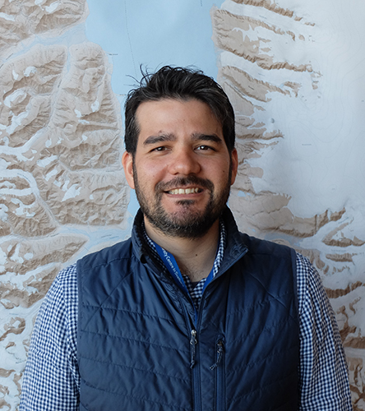
Geo-MOD: Idea and Team
Sara Mollie Cohen
Course organizer
Peter Betlem
Course organizer/Instructor
5.5-day course:
Classroom & field teaching using open, online compendiums
Best-practices from field to classroom
Limited to 10 participants → Ensure in-person teaching
Important hands-on practice
Available to all levels: students (BSc, MSc, PhD) and staff (scientific/technical)
Nil Rodes
Course organizer/Instructor
Rafael Horota
Field Instructor

Slide 3
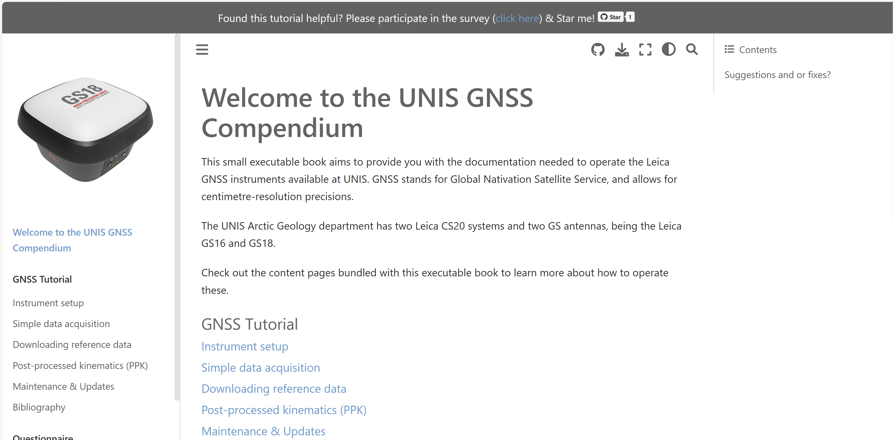
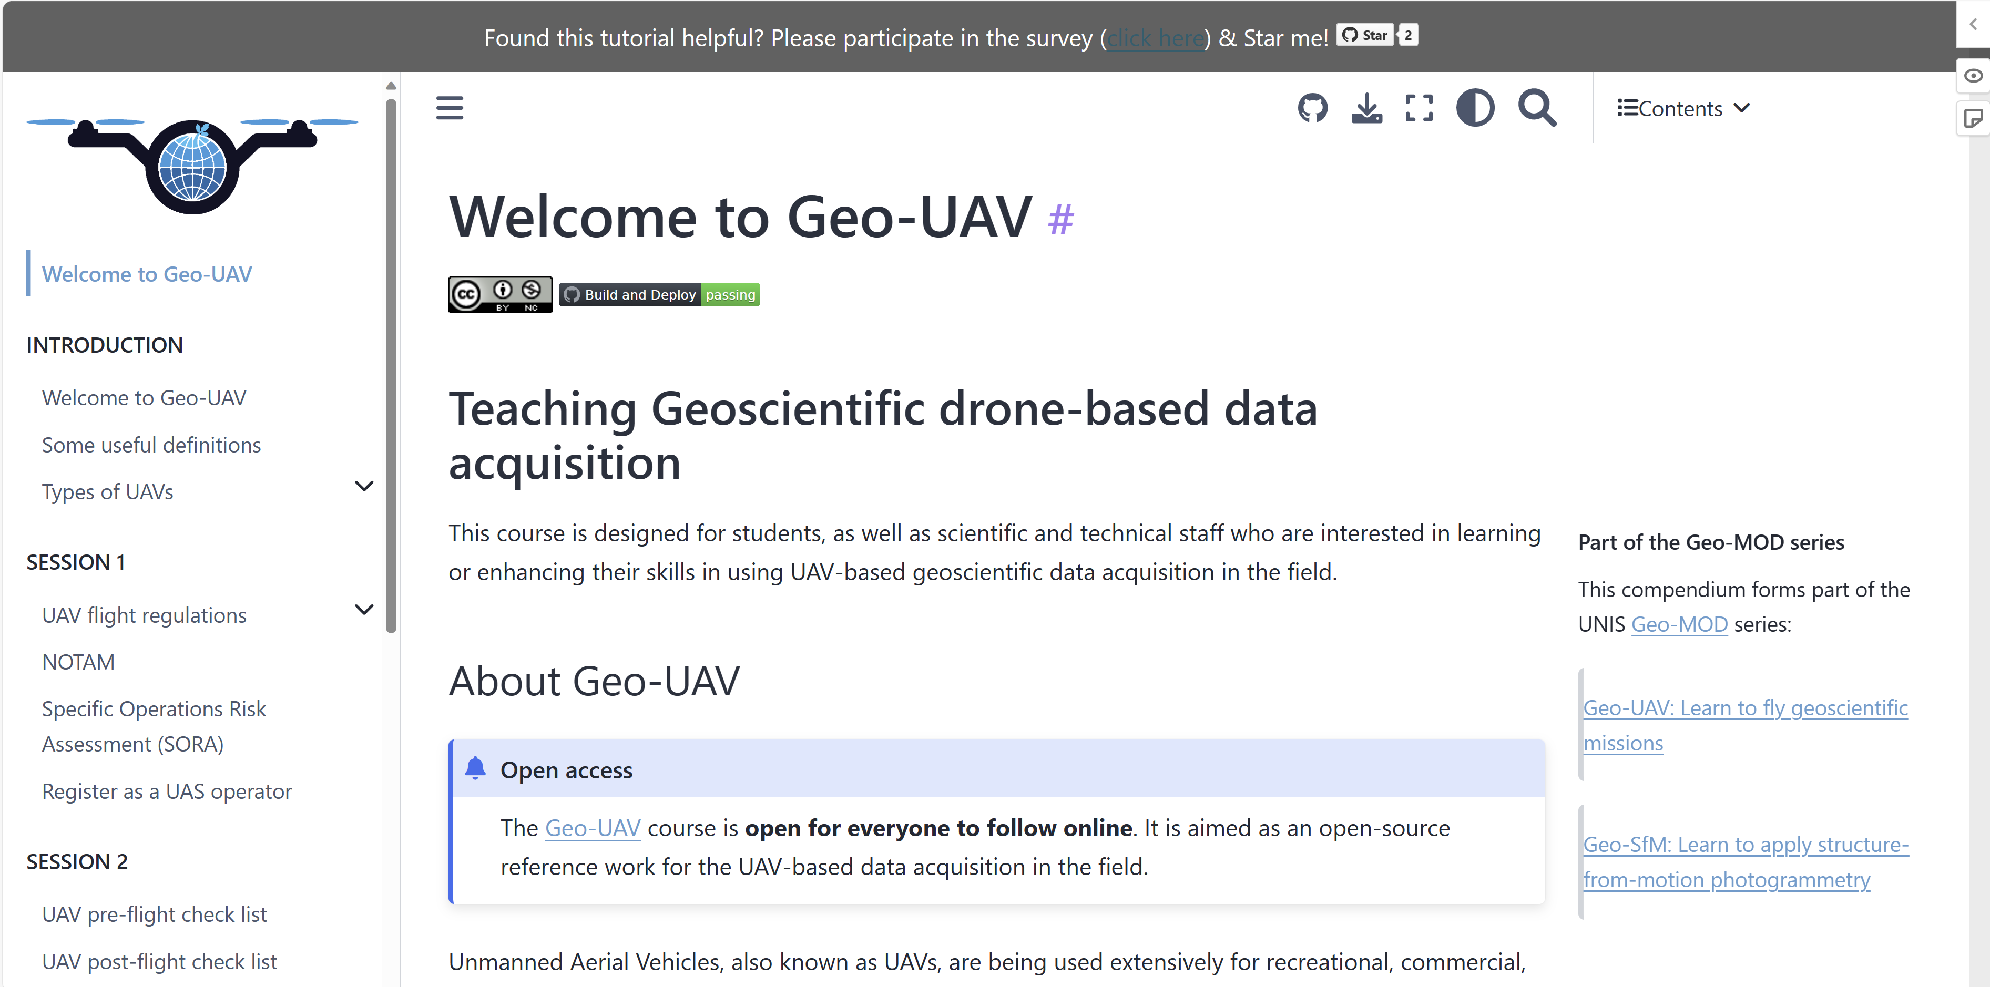
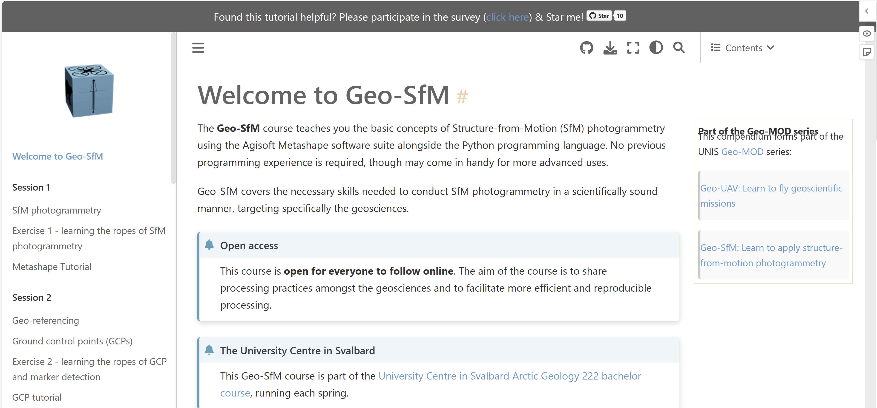
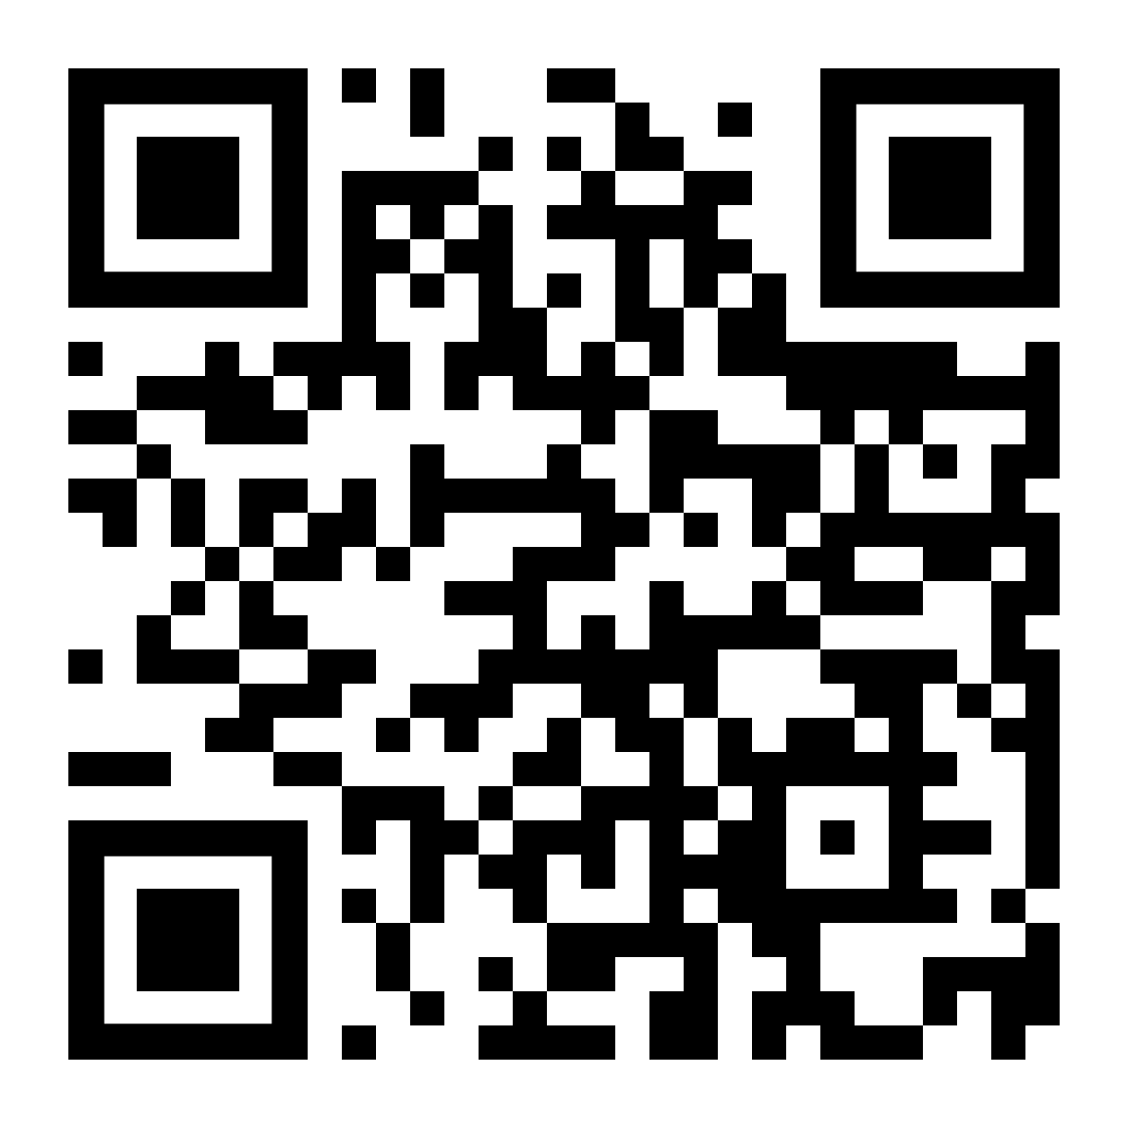
Geo-MOD & Open eBooks@UNIS
https://unisvalbard.github.io/ebooks/
Interactive tutorials/videos on how to use equipment
Lectures, slides, practicals and background information on how to fly UAVs
Lectures, slides, practicals and background information on photogrammetry

Slide 4
Geo-MOD & Open eBooks@UNIS
SoTL ongoing:
currently in draft, in submission 2023
Interactive tutorials/videos on how to use equipment
Technical show-case for tool documentation
Lectures, slides, practicals and background information on how to fly UAVs
Latest eBook, part of Geo-MOD
Lectures, slides, practicals and background information on photogrammetry
First eBook, part of Geo-MOD

Slide 5
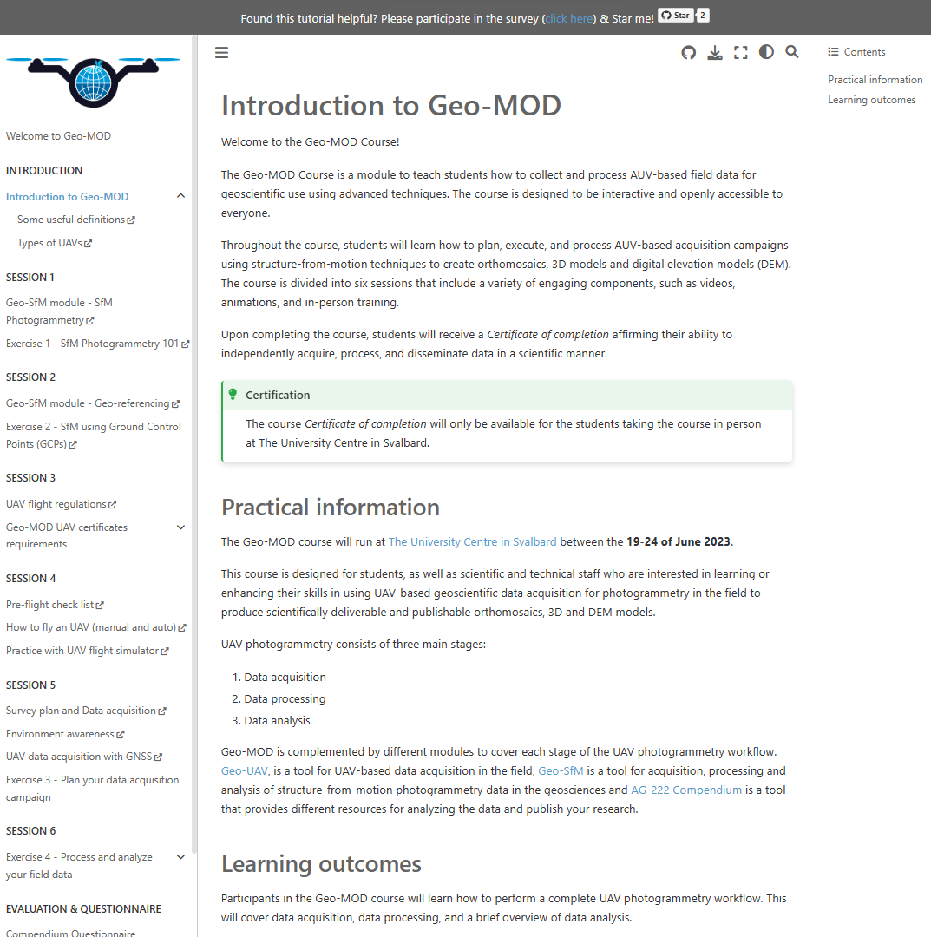
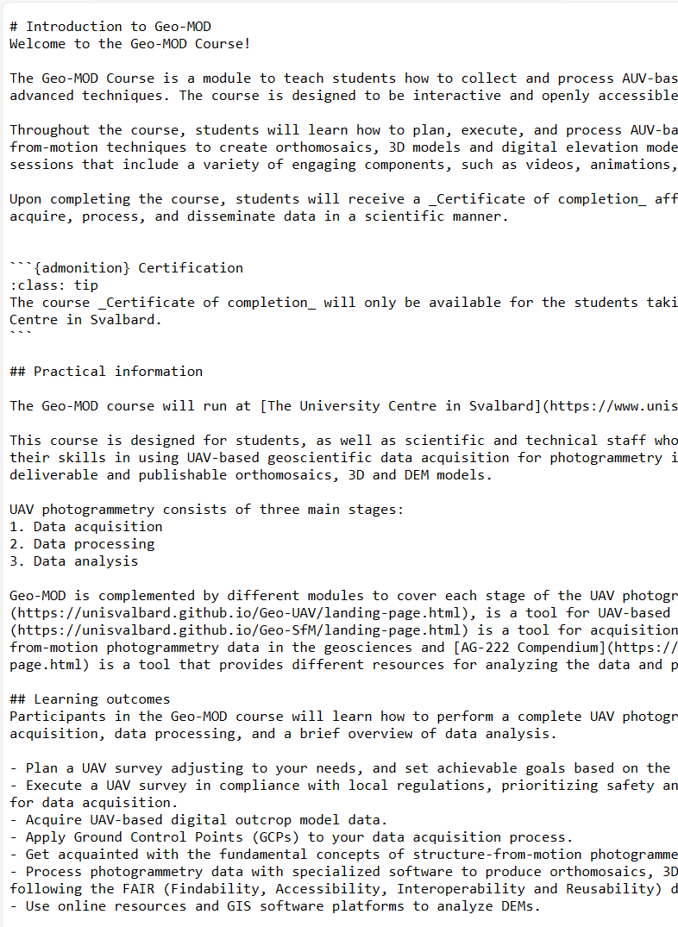
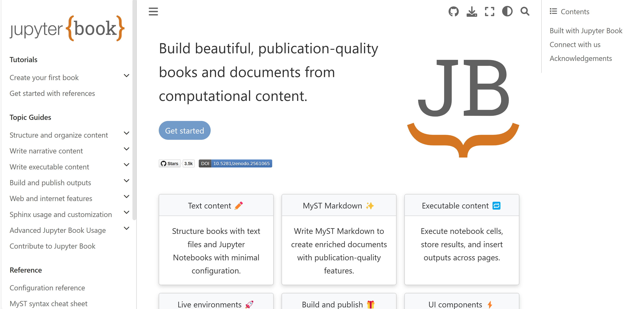
Built with Jupyter Book
Lasting, FAIR & open online access (including to externals)
Interactive/executable material:
Animations, videos, links, online maps, online coding

Slide 6
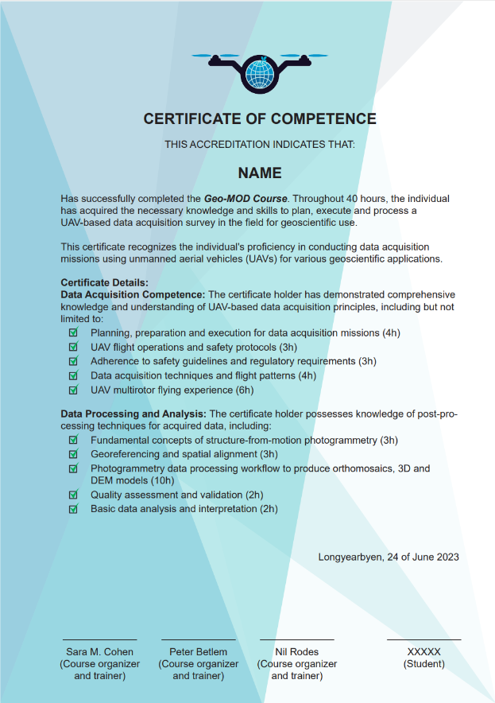
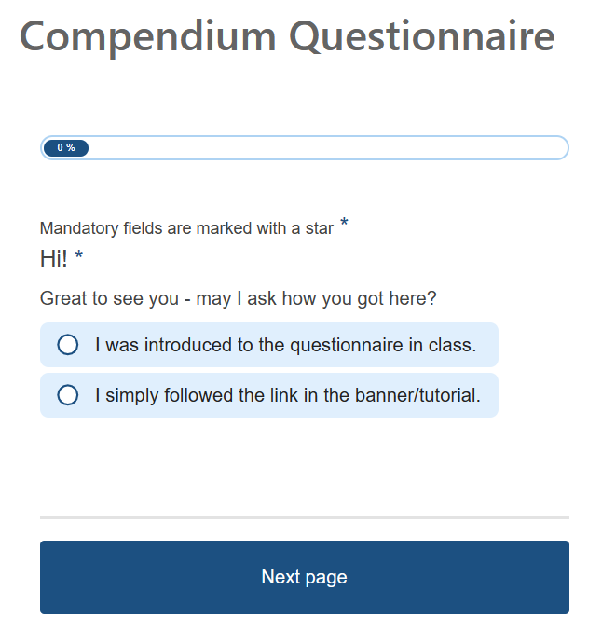
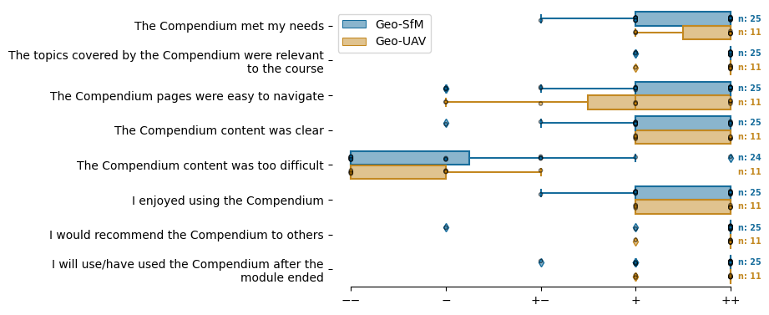
Using Jupyter Book as an open online teaching environment: Take-aways from Geo-SfM and Geo-UAV
Implemented in several UNIS AG courses.
Geo-MOD 2023 was a success.
High participation demand.
Applicable in other places.
Let’s discuss the next eBook?
Betlem et al., draft

Slide 7
Contact & questions
BetlemTech@outlook.com
FAIR digital documentation & teaching

