Slide 1
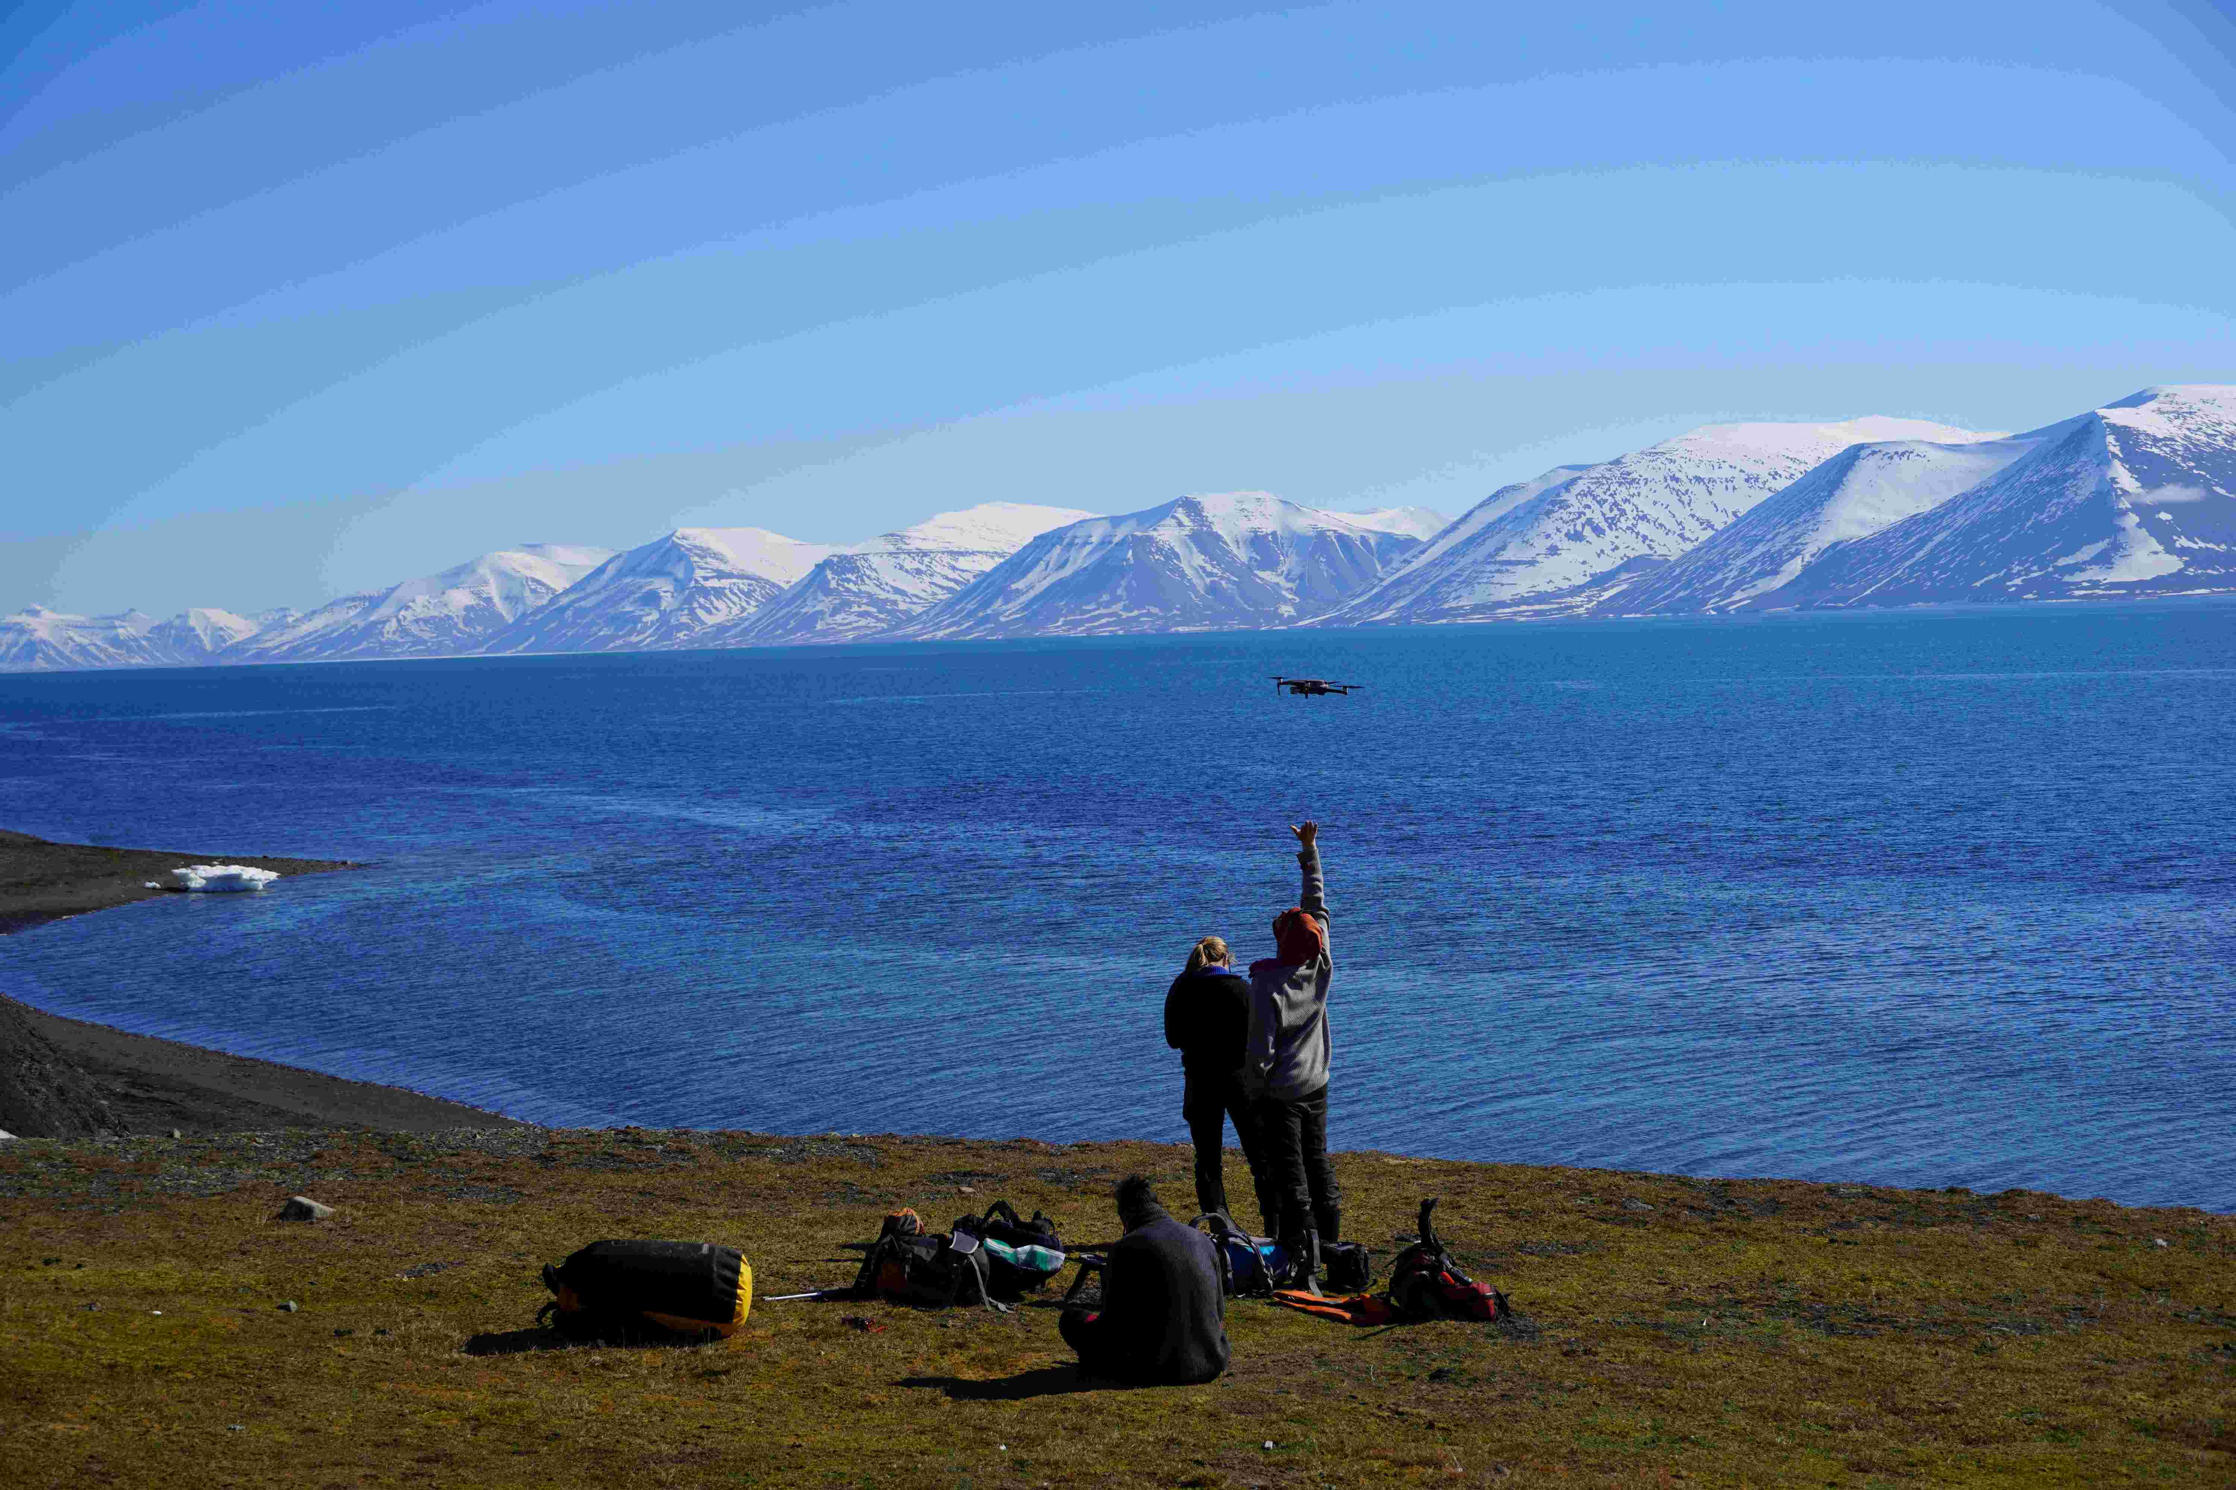


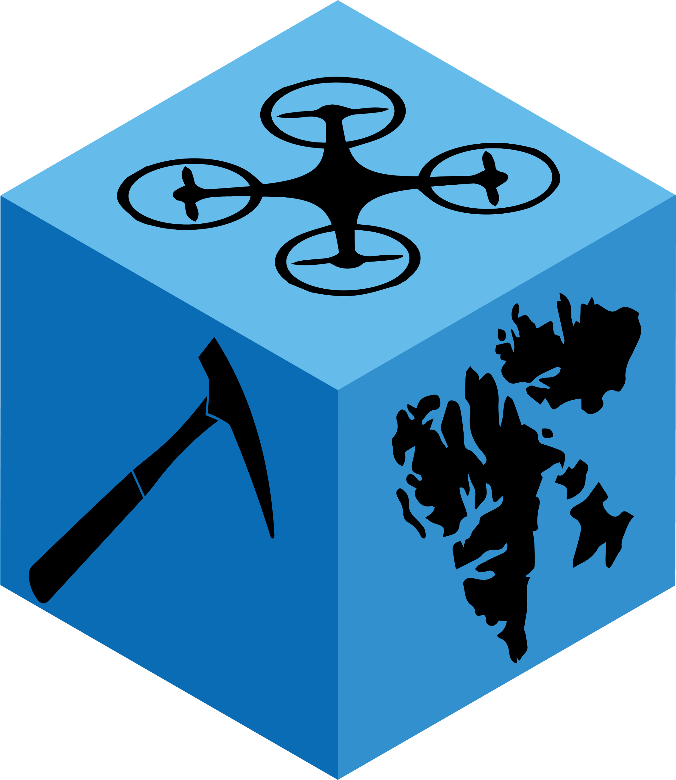
Survey plan and data acquisition
Planning a photogrammetric survey for a fit-for-purpose 3D model

Slide 2
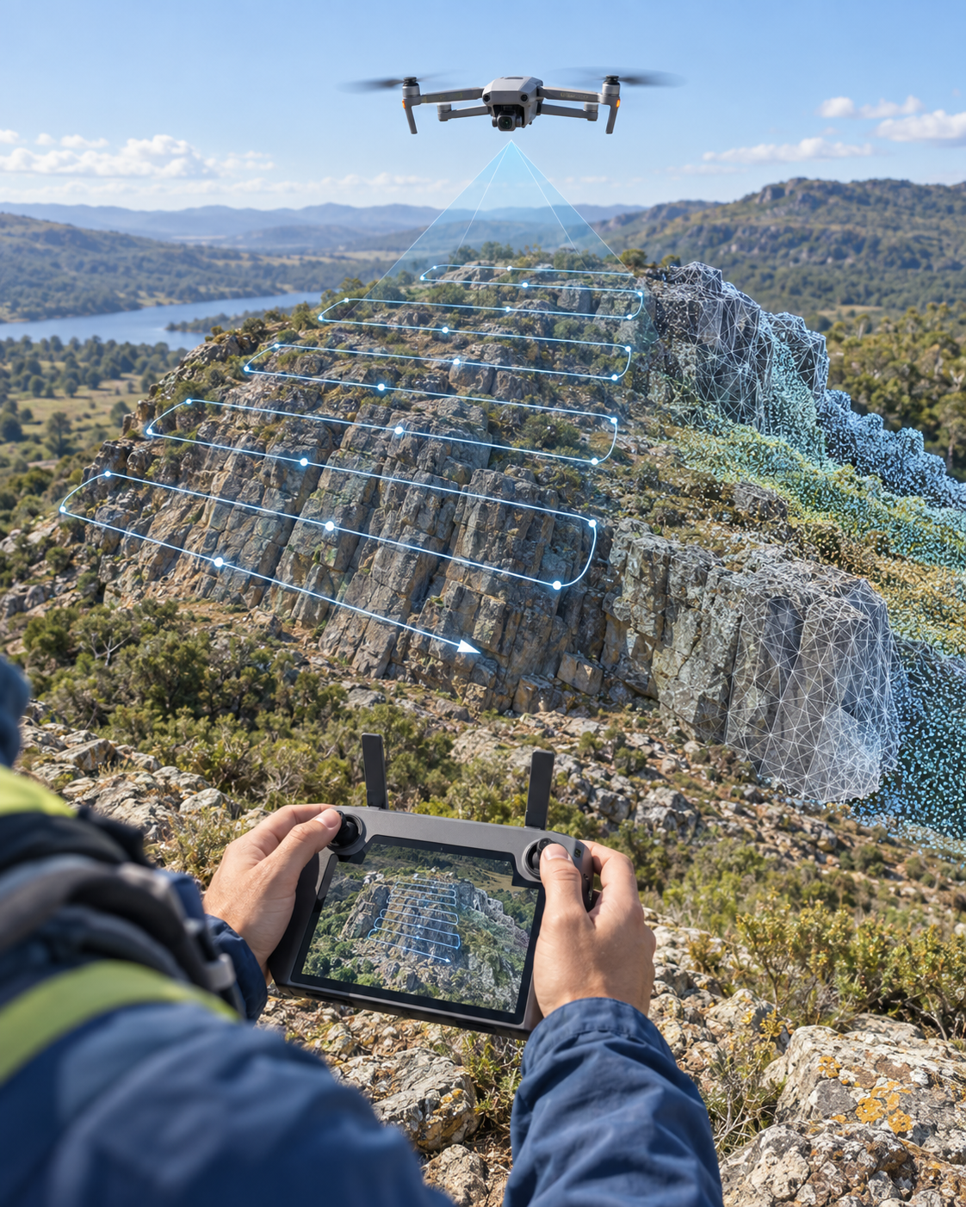
Learning outcomes
• Define an acquisition objective
• Select a feasible survey design
• Set up a camera for photogrammetry
• Plan flight coverage and contingencies

Slide 3
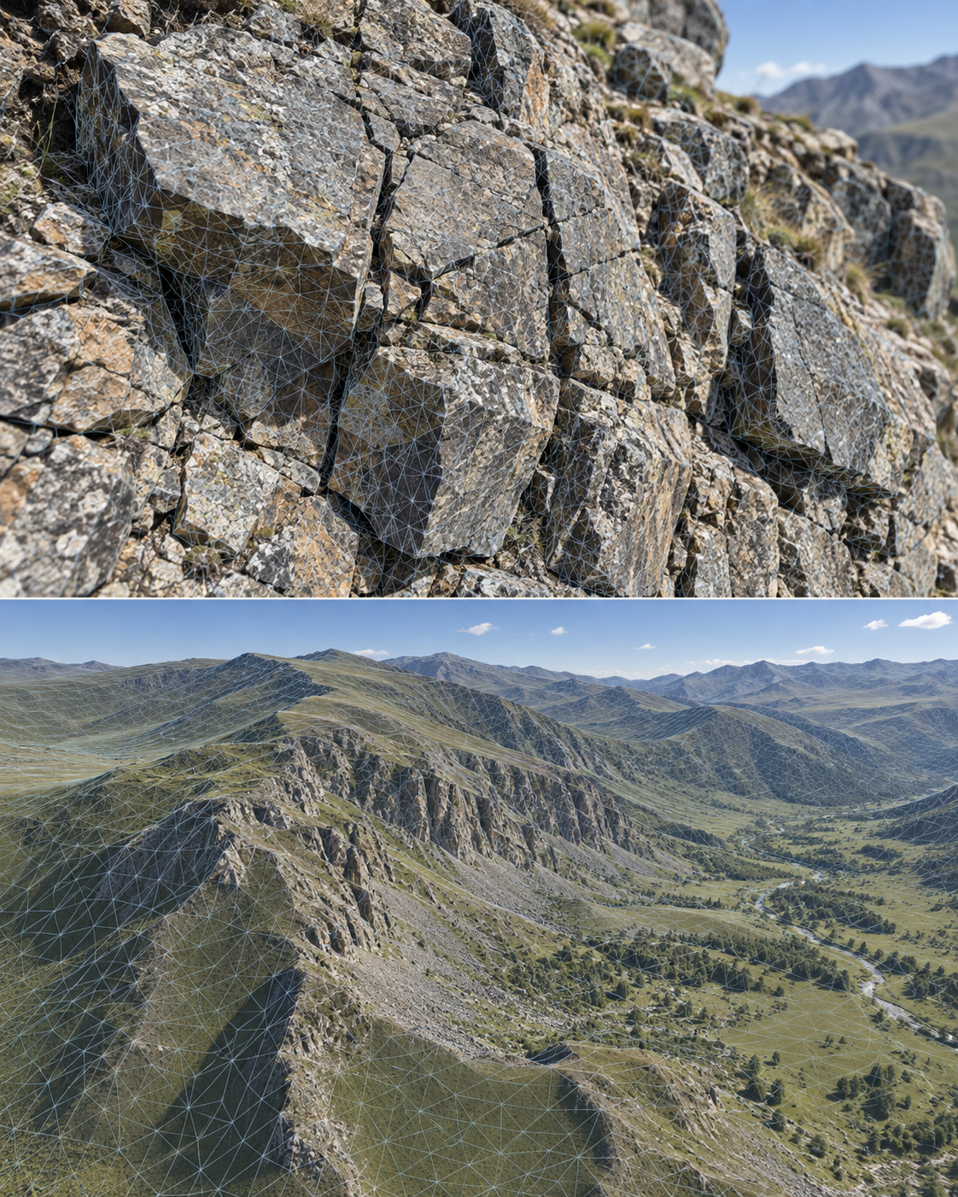
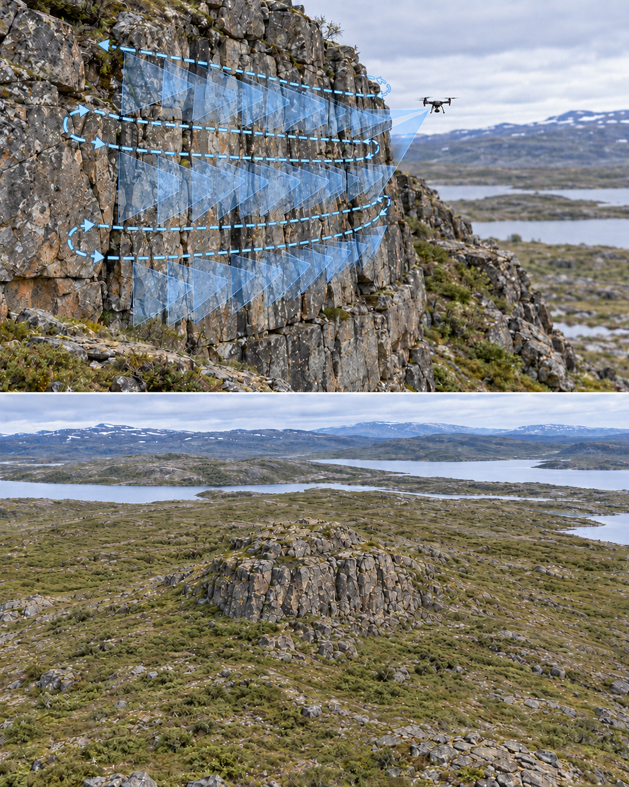
Target outcome?
What do you need to measure or interpret?
The objective determines the required area, resolution, accuracy, viewpoints, and level of detail.
A detailed fracture model and a regional terrain model need different surveys.

Slide 4
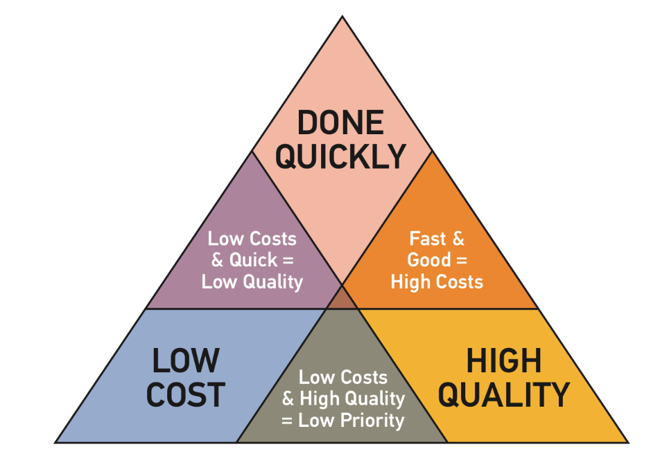
Time, resources, and quality
A survey plan balances three constraints:
• Time available for acquisition
• Resources: aircraft, batteries, personnel, camera, and processing capacity
• Quality: coverage, resolution, and measurement accuracy
Source: https://www.kinetechcloud.com/hubfs/Project-Management-Triangle-1.png

Slide 5
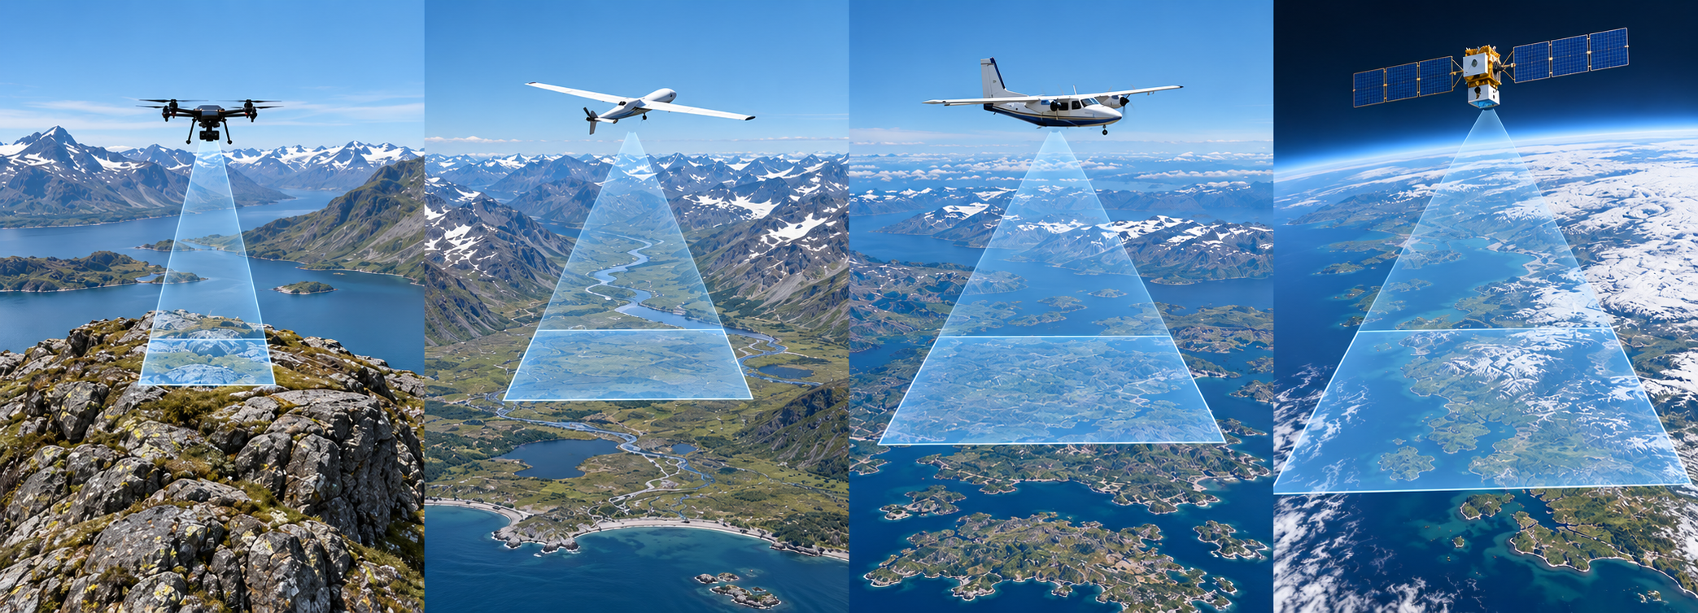
UAV choice and system limits
Multirotors suit close-range outcrops and manual flying.
Fixed-wing UAVs cover large horizontal areas efficiently.
For comparison: Aeroplanes and satellite data may cover up even larger areas still. Each areal increase typically coincides with a resolution decrease.
Battery duration, wind, payload, GNSS accuracy, and line of sight constrain every survey.

Slide 6
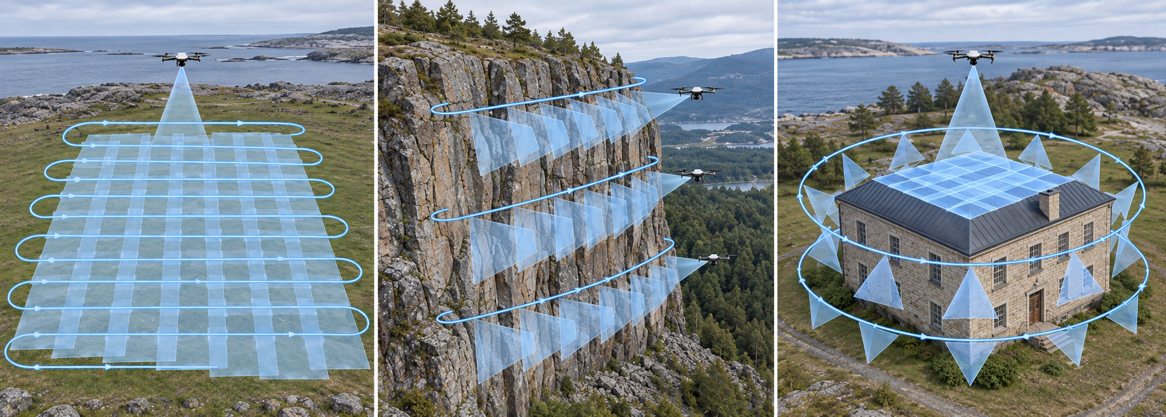
A feasible survey site
When selecting a site, identify the appropriate surveying patterns.
Check take-off and landing areas, visibility, terrain, wind exposure, and escape options.
Check estimated flight times and adjust based on target resolution.

Slide 7
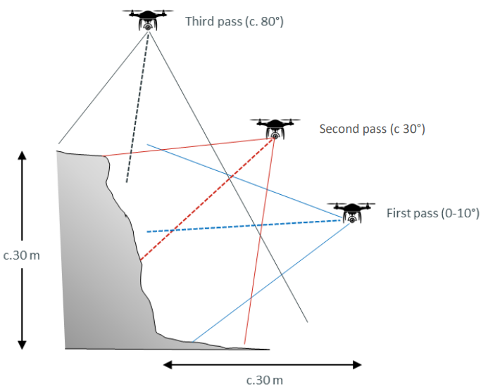
Flight geometry for a vertical outcrop
Fly sideways along the cliff with the camera facing the outcrop.
Maintain at least 70% image overlap.
Use two passes as a minimum. Three passes provide stronger coverage and viewing geometry.
Low pass: near-horizontal view, about 10° tilt.
Middle pass: higher position, 30–40° camera tilt.
High pass: higher position, about 80° camera tilt.
Add overview images from farther back.

Slide 8
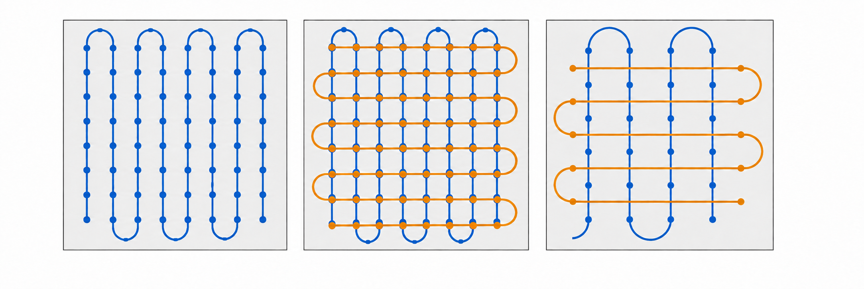
Horizontal surfaces and mixed terrain
For planar ground, fly a regular grid with a downward-facing (at about 70-80°) camera.
  Single grid for simple planar ground
  Cross-grid for stronger multi-directional coverage
  Maintain overlap between adjacent lines.
Add oblique passes at about 40° where ledges, shelves, or vertical faces matter.

Slide 9
Coverage, sections, and field notes
Divide long outcrops into manageable sections.
Keep overlap between adjoining sections for later model registration.
Record take-off sites, flight direction, camera settings, weather, and any gaps in coverage.

Slide 10
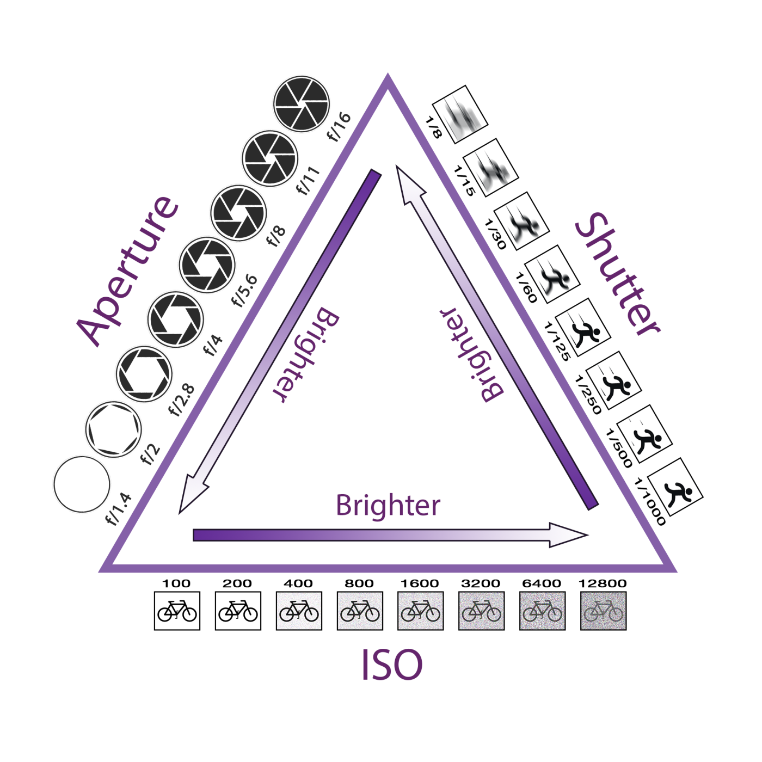
Exposure triangle
Aperture controls light and depth of field.
Shutter speed controls exposure time and motion blur.
ISO amplifies the signal and adds noise.
Source: The Exposure Triangle, 2017

Slide 11
Camera setup before take-off
Use JPG for routine acquisition. Use RAW only when difficult or changing light requires later exposure adjustment.
Set white balance manually to match the conditions.
Focus on the subject before starting the image sequence.

Slide 12
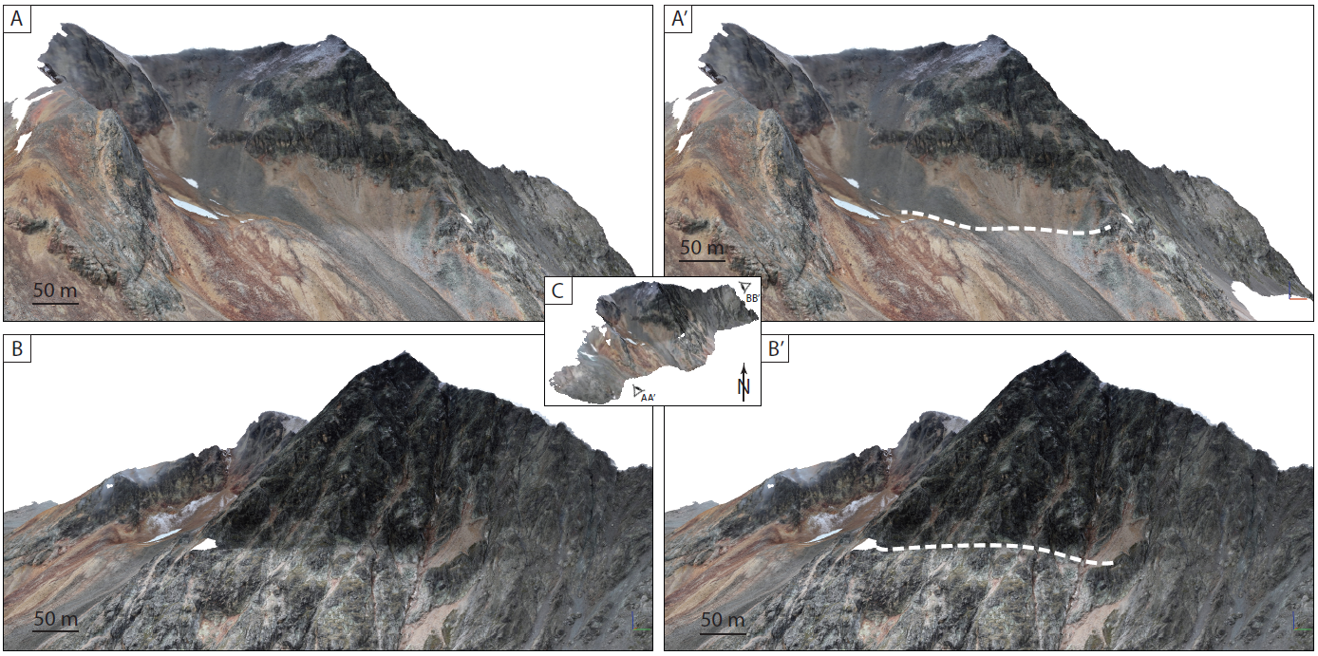
Light and shadows
Even illumination improves matching and texture quality.
Bright overcast conditions usually provide the most reliable light.
Harsh sunlight, deep shadows, flare, and backlighting hide detail and complicate processing.
Source: Morzelle et al. (2026), ESSDD - High-resolution Digital Outcrop Dataset of a Fossil Hyperextended Rifted Margin, Swiss Alps

Slide 13
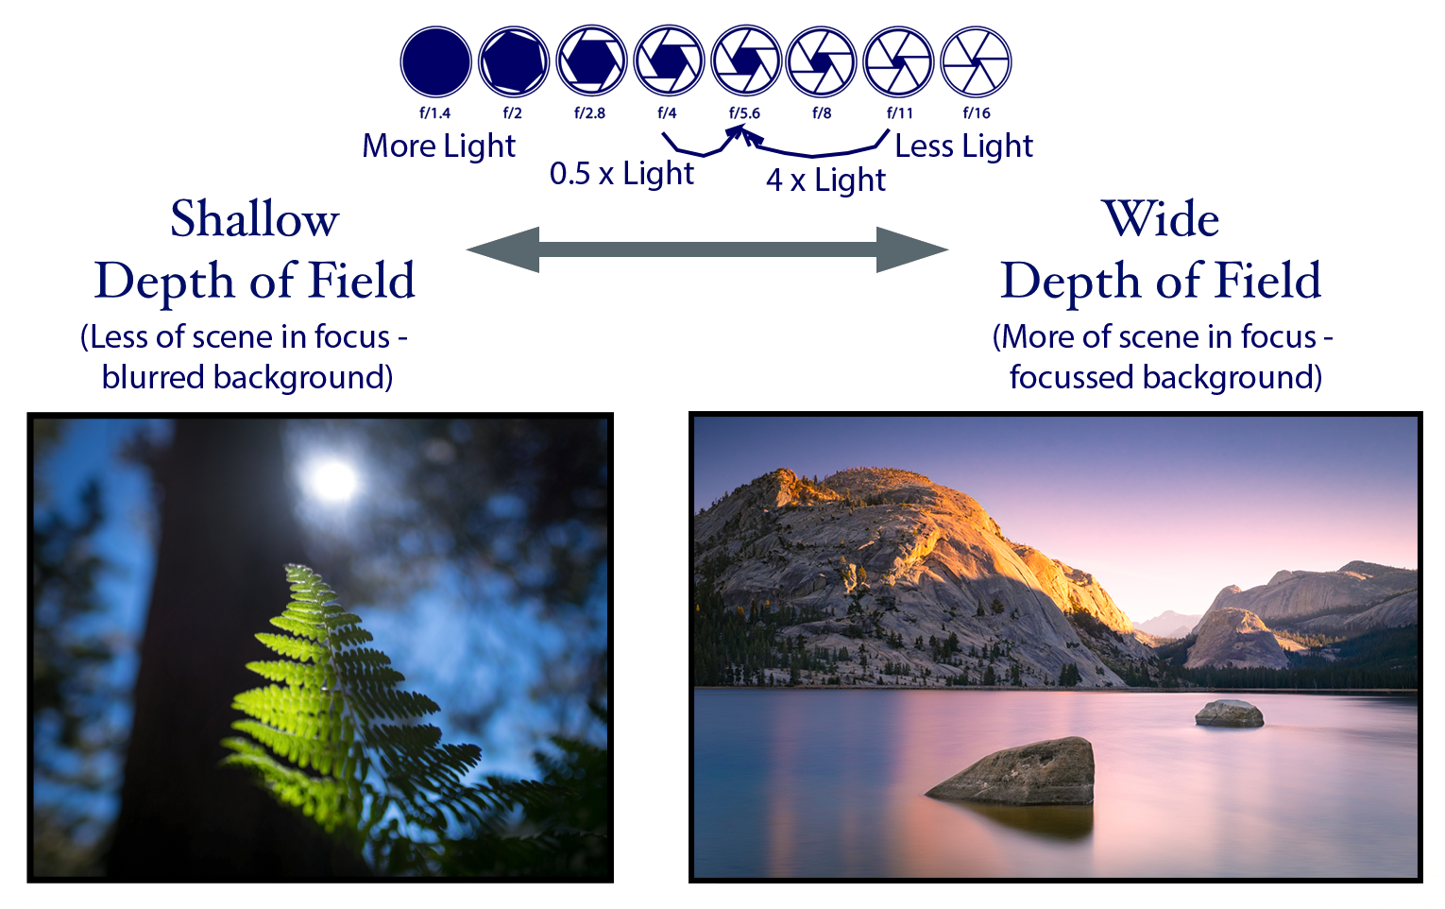
Image quality during flight
For sharp, consistent images:
• Use a small aperture when light permits
• Keep shutter speed fast enough for aircraft motion
• Keep ISO as low as practical
• Use a fixed white balance for a consistent image set
Source: Understanding Aperture and Depth of Field, 2017

Slide 14
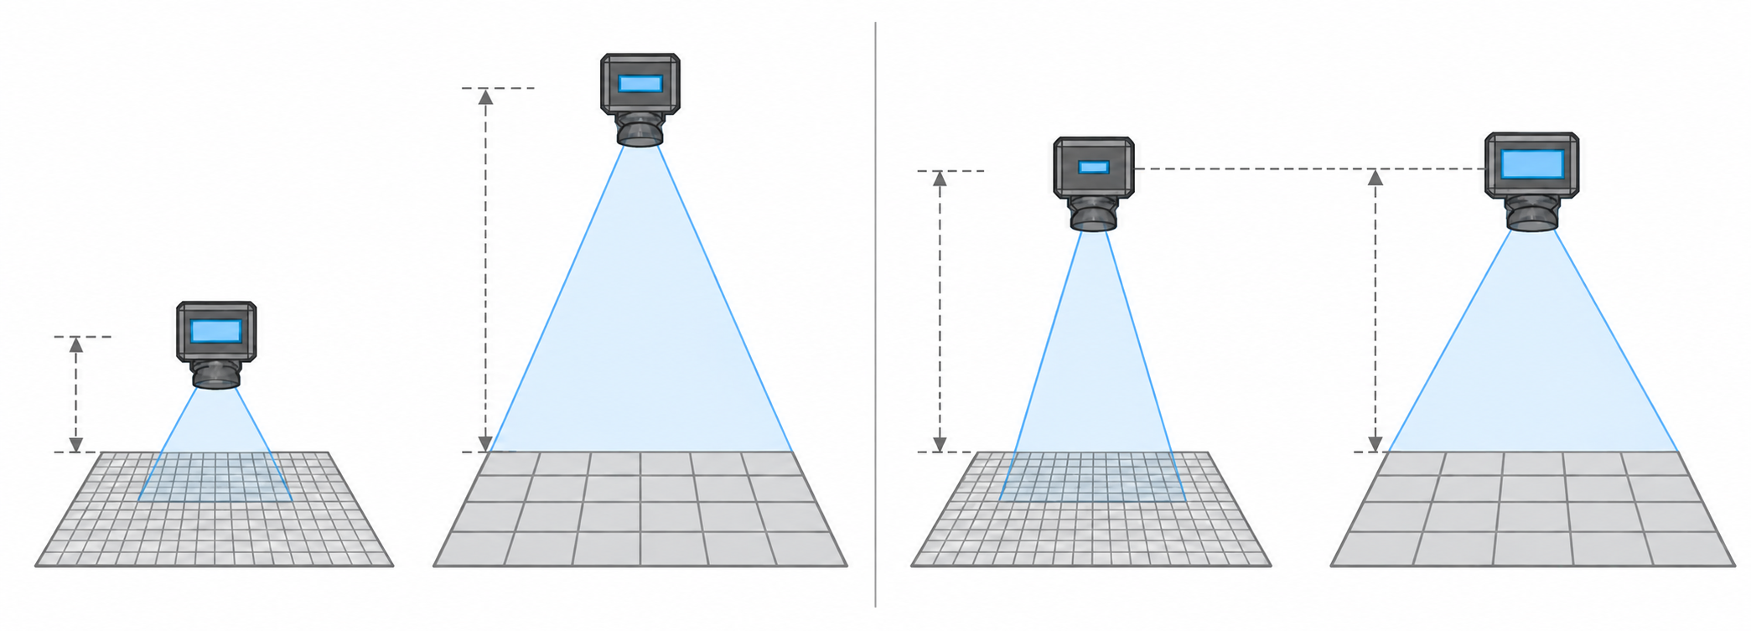
Resolution and ground sampling distance
GSD is the ground distance represented by one pixel.
Higher resolution requires flying closer, which reduces the area covered per image.
For Mavic/Phantom-type cameras, about 30 m from an outcrop is a useful rule of thumb for sub-centimetre pixels.
At constant focal length, sensor size, and pixel count, a closer distance gives finer GSD but a narrower footprint.
At constant distance, focal length, and pixel count, a smaller sensor gives finer GSD but a narrower footprint.

Slide 15
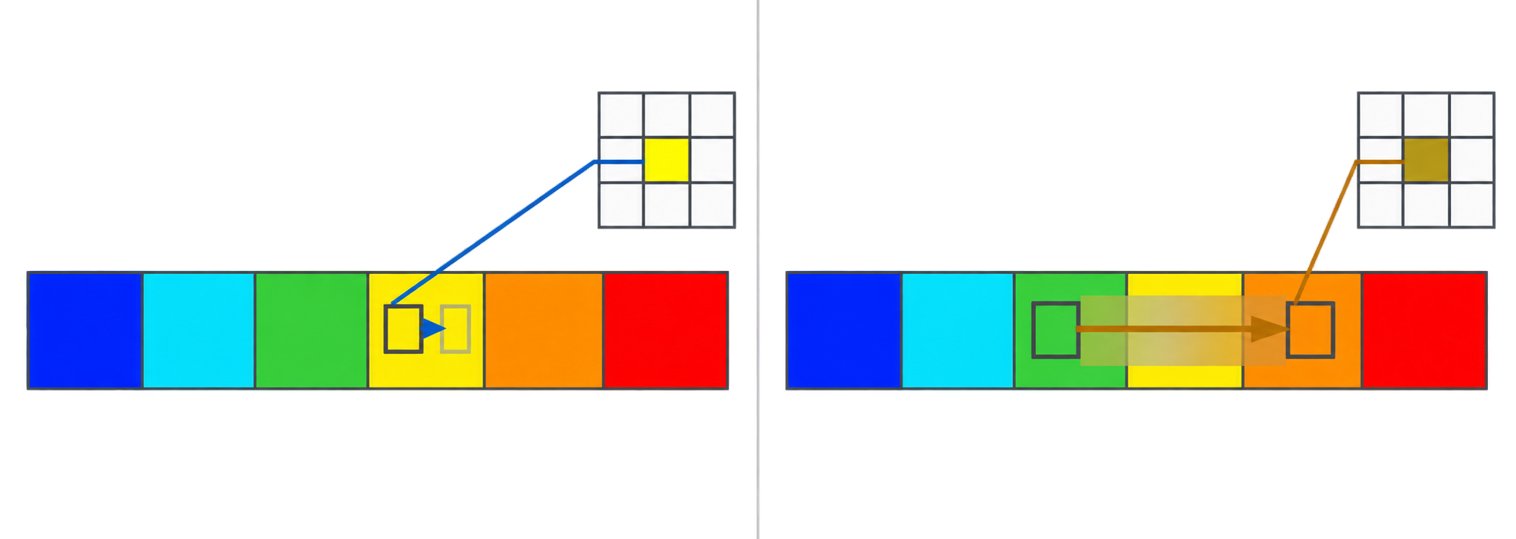
Blur and coverage: image interval and aircraft speed
Choose an interval that provides enough overlap without collecting unnecessary images
Choose an appropriate aircraft speed to avoid imaging blur.
  Detailed outcrop: about 3 s at 1 m/s
  General outcrop: about 5 s at 3–4 m/s
  Large overview: about 7 s at up to 10 m/s
SSₘₐₓ = GSD / V
SSₘₐₓ: maximum shutter time (s)
GSD: ground sampling distance (m); V: aircraft speed (m/s)

Slide 16
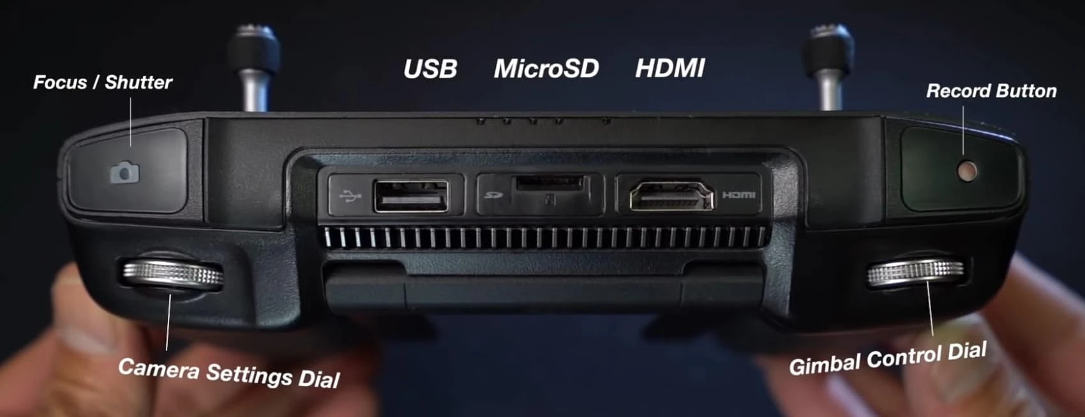
Controller actions during acquisition
Use the controller to maintain the planned path and check image capture.
Gimbal dial: camera angle
Focus/shutter button: focus and capture
Map display: flight path and coverage
Source: Geo-UAV, Survey plan and Data acquisition | Image: flyingcdn (2020), DJI smart-controller layout, via Geo-UAV

Slide 17
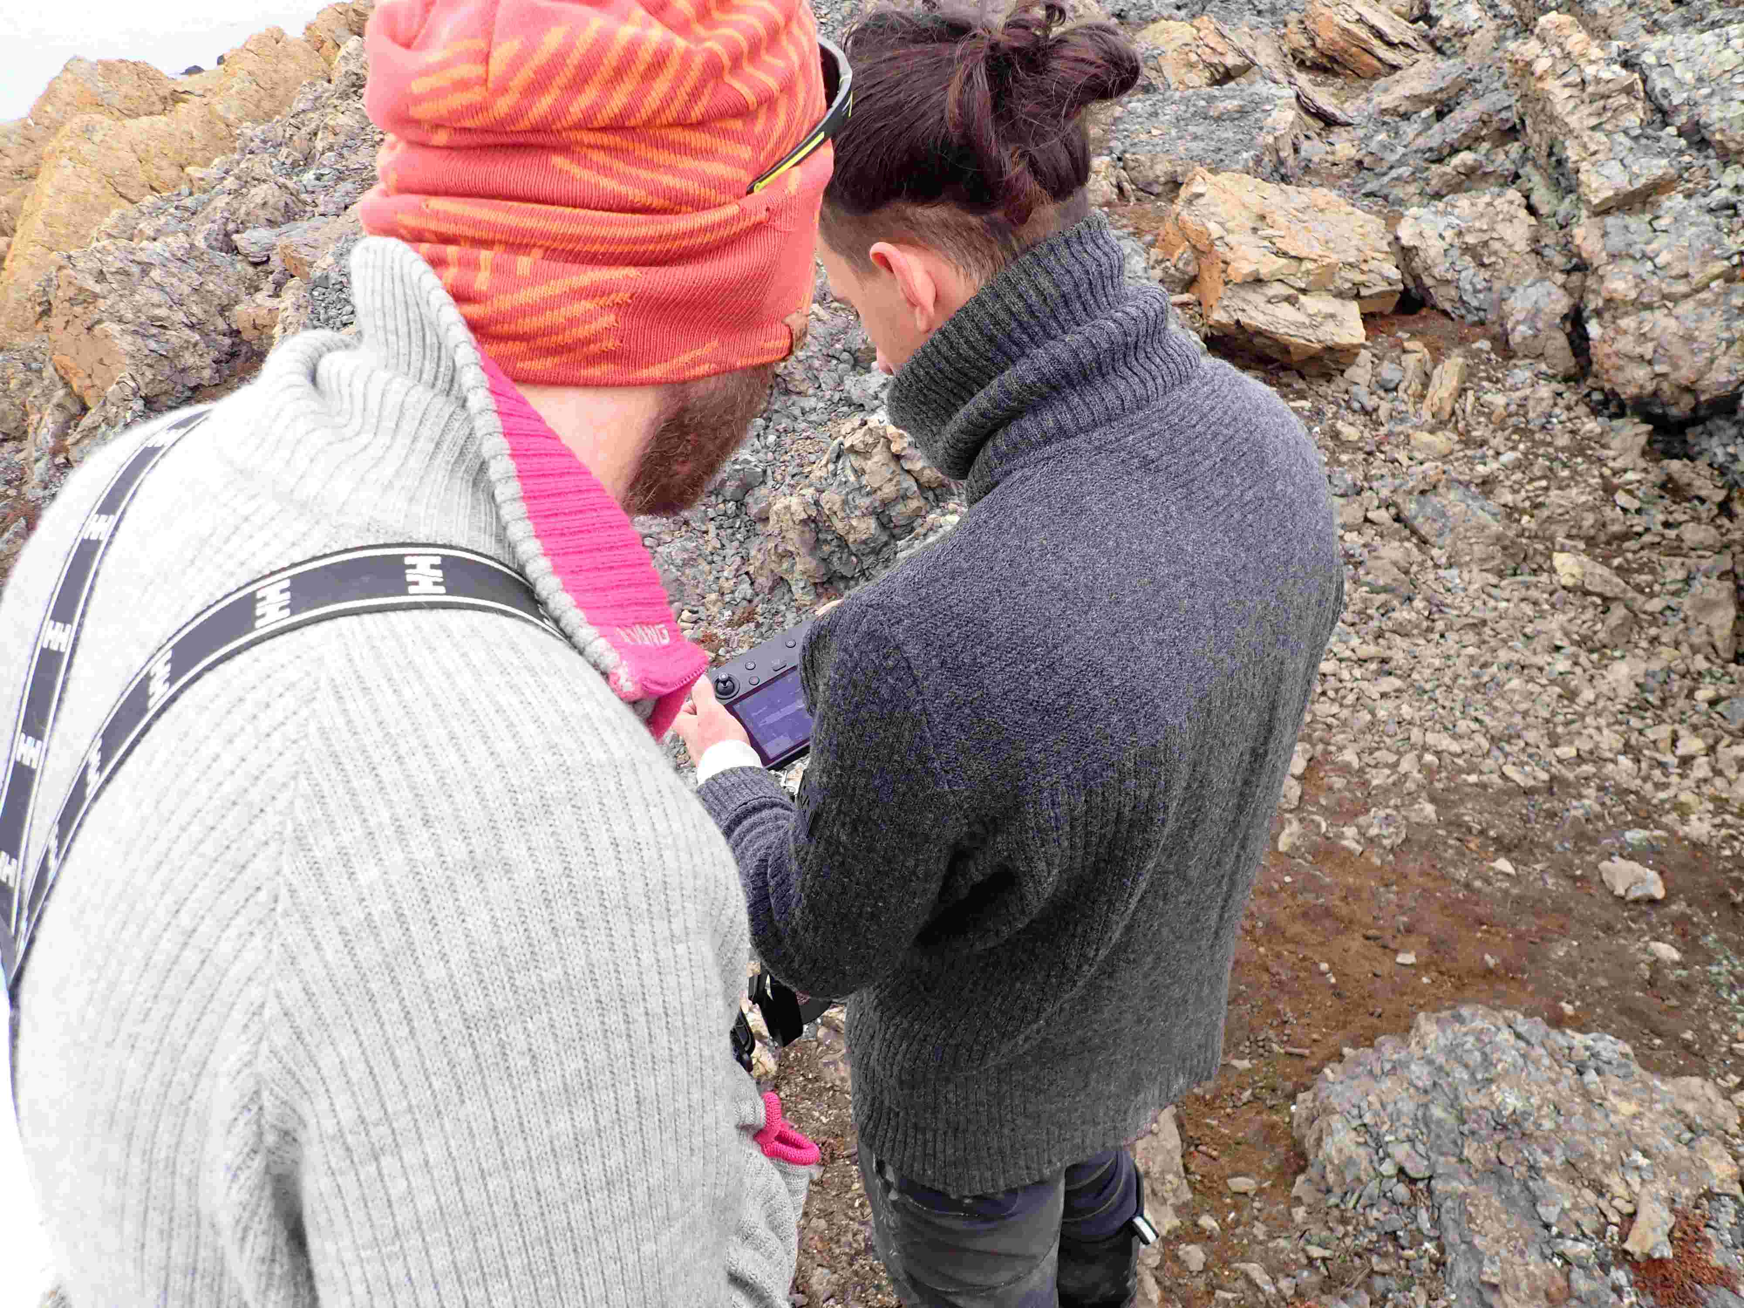
Contingency plan
Before launch, agree on:
• A safe landing area
• Actions for low battery or connection loss
• Communication between pilot and observer
• Conditions that require the flight to stop

Slide 18
Basic planning before the first flight
Objective: What model or measurement is required?
Site: What can be flown safely and legally?
Acquisition: What resolution, lighting, camera settings, and flight pattern are needed?
Resources: Who flies, what equipment is available, and what is the contingency plan?

